Slide 1

Interpersonal Communication
Module 5(ITW)
Department of Humanities.
.

Slide 2
Objectives
Interpersonal role of a manager
Dimensions of interpersonal relationship
Role of communication in IPR
Power of active listening
Self assessment: Some models in practice
  Communication style
  Emotional Intelligence.

Slide 3
Interpersonal relationship
Reciprocal social and emotional interaction between two or more individuals in an environment
Close association between individuals who share common interests and goal

Slide 4
Forms of IPR
Friendship
Family and kinship
Professional relationship
Love
Marriage
Platonic relationship
Casual relationship
Brotherhood and sisterhood
Acquaintances

Slide 5
IPR for an individual
Personal growth and development
Growth and enjoyment
Sense of security
Context of understanding
Interpersonal needs
Establishing personal identity

Slide 6
IPR for Engineers.
Understanding self
Building a positive functional multidisciplinary team
Improving intra and/or inter team communication, coordination and cooperation
Improved decision making and problem solving

Slide 7
Communication is the KEY
Half the world is composed of people who have something to say and can't, and the other half who have nothing to say and keep on saying it.
Robert Frost
To say nothing, especially when speaking, is half the art of diplomacy.
- Will Durant

Slide 8
How does communication fail?
The single biggest problem in communication is the illusion that it has taken place.
- George Bernard Shaw

Slide 9
Interpersonal Relationship
All work is done through
Self
One to One
Group members
In all work is done, through Relationships

Slide 10

Being Empathetic
the ability to put your feet in other person’s shoes, to feel what it’s like to be there and to care about making it better so that it does not hurt.
a hypothesis we make about another person based on a combination of emotional, and cognitive information...an attempt to experience the feelings of others while retaining objectivity.

Slide 11
Six habits of empathic people
Cultivate curiosity about strangers
Challenge prejudices and explore commonalities
Try another person’s life
Listen hard and open up
Inspire mass action and social change
Develop an ambitious imagination

Slide 12

Assertiveness
Enables an individual to act with his or her best interests without denying upon the rights of others
Allows people to speak their minds without hurting or threatening others
Allows people to express anger or disappointment without acting aggressively but making the point clear,

Slide 13
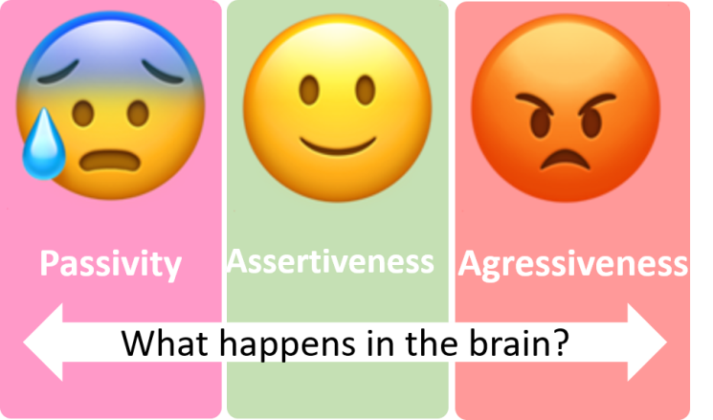


Slide 14
Assertive communicators…
are open about their feelings
are not anxious; they can be calm on stressful occasions.
are contentious; stand up and argue for their rights even if this might call for certain disagreement or conflict
are not intimidated and are not easily persuaded by others

Slide 15
Developing assertiveness
Acknowledge that people are responsible for their own behavior
Express negative thoughts and feelings in a healthy and positive manner
Identify your needs and wants, and ask for them to be satisfied
Value yourself and your rights
Receive criticism and compliments positively
Learn to say "No" when you need to- the key to assertiveness

Slide 16
1 Minute Exercise
List as much people as you can who you would like most
List as much people as you can who you dislike most

Slide 17
Emotional Intelligence
is a method of understanding communication between people;
EIis a system of analysing and understanding human relationships;
It is not about what is said but how it is said.

Slide 18
What is Emotional Intelligence
Emotional intelligence (EI) is the capacity for understanding our own feelings and the feelings of others, for motivating ourselves, and for managing our emotions effectively in our relationships.
Notes:
This is the most common definition of emotional intelligence

Slide 19
Emotional Intelligence (contd.)
The most widely accepted view of emotional intelligence identifies 20 competencies, which are in turn organized into four clusters:
Self-Awareness
Self-Management
Social Awareness
Social Skills

Slide 20
Four Clusters of Emotional Intelligence
1. Self-Awareness
2. Self-Management
3. Social Awareness
4. Social Skills
Notes:
Now that we know why EI is important to know about in genral, I am going to go into detail about what EI actually involves. EI consists of four clusters, each containing competencies which total 20 in all. Not only am I going to tell you what they are and why they are important, I am also going to tell you how you can develop and improve on them.

Slide 21

THE POWER OF
LISTENING

Slide 22
Worth of listening
It is not the voice that commands the story; it is the ear.
- Italo Calvino
The most important thing in communication is hearing what isn't said.
- Peter Drucker

Slide 23
Thought of the hour
The biggest communication problem is we do not listen to understand.
We listen to reply.

Slide 24
Self-Management
Self-Management is the ability to understand your emotions and then use that understanding to turn situations to your benefit.
Self-management is also the ability to use your feelings to reason well and act intentionally.
Notes:
The second cluster in emotional intelligence is Self-Management.

Slide 25
Motivation
Abraham Maslow was an American born psychologist, researcher and educator who practiced during the middle third of the 20th century.
Maslow created his now famous hierarchy of needs based on his observations that some needs take precedence over others.

Slide 26
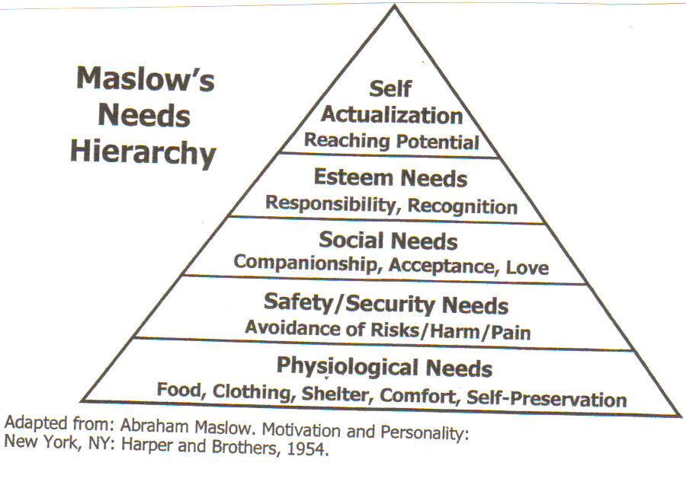
Motivating(Cont.)

Slide 27
Building a Team
Share ideas
Listen to and show respect for others
Talk more about “we” and less about “I” and “me”
Understand and use each others know-how
Know about each other’s personal lives
Give each other help and support

Slide 28
Brainstorming Process
Everyone must be involved
Call out ideas to scribe
Build on ideas
No idea is too trivial or silly
There is no criticism nor judgment on any idea
Get as many ideas as possible in the time
Objective: solve problems and enjoy doing it

Slide 29
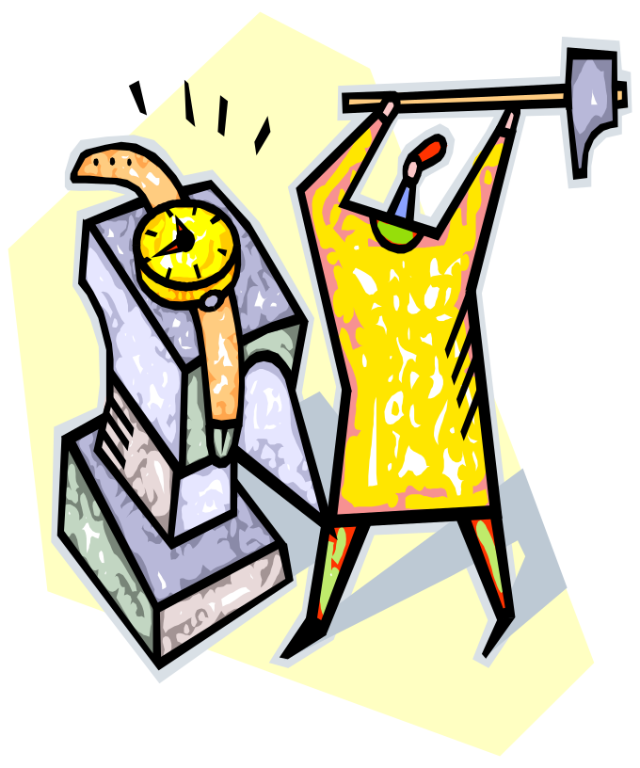
Myths about Time Management
Time management is nothing but common sense. I do well in school, so I must be managing my time effectively.
It takes all the fun out of life!!!
Time management? I work better under pressure.
No matter what I do, I won’t have enough time!

Slide 30
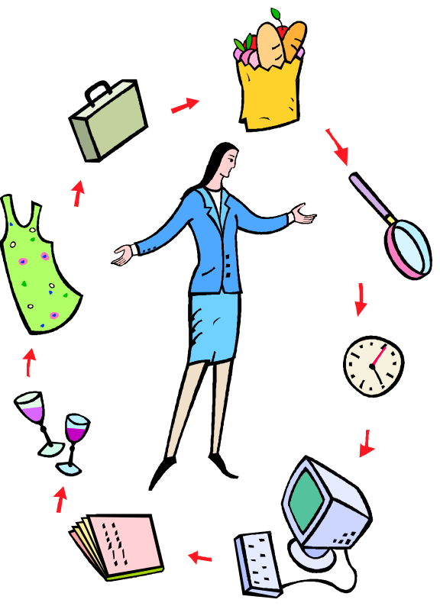
The Truth About Time Management
Increases productivity.
Reduces stress.
Improves self-esteem.
Helps achieve balance in life.
Increases self-confidence
Helps you reach your goals!

Slide 31
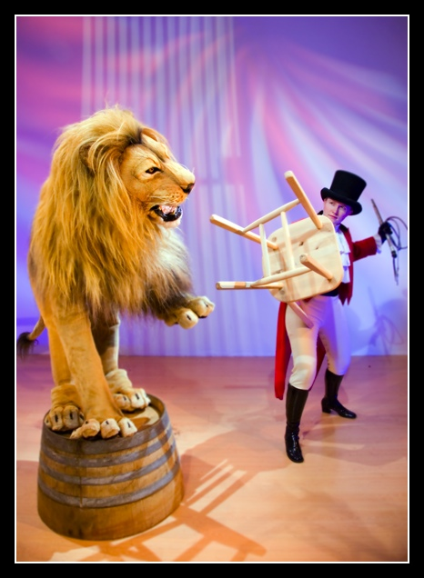
Steps to Managing Your Time
Set goals
Set reasonable expectations (and remember that no one’s perfect)
Make a schedule
Revisit and revise your plan

Slide 32

From Goals…Set priorities
What’s important and what isn’t?
What order do things need to be done in?
Once you know what your priorities are, you need to plan out a schedule for the semester, the week and the day.
Acknowledge the realities of college schedules.
Planning may seem hard at first, but the more you do it, the easier and more natural it gets.

Slide 33

Make a Schedule
Set Up Your Semester Calendar
Block all important set time obligations.
Block all class and lab times.
Look at the syllabus for the class schedule.
  Note the weight of the activities.
  Highlight all exams and project due dates.
Work backwards from exams and papers (PERT).
Study time.
Time for your sanity.

Slide 34
Procrastination
Procrastination is my sin.
It brings me naught but sorrow.
I know that I should stop it.
It fact, I will – tomorrow!

Slide 35
Tackle Time Wasters
Learn to recognize when you’re wasting time.
Decide what you need to do and can realistically do.
Learn how to say “NO” when you don’t have time.
Return calls at your convenience. The phone is a major time killer.
Learn to say “I can’t talk right now. I’ll get back to you.”
Wasting time is often linked to a lack of self-discipline.
Ask yourself, “Do I really need to do this or not?”

Slide 36

Learn to say “No!”
Avoid the temptation to socialize when you’ve scheduled work.
If friends ask you to join them last minute, decline outright, but ask if you could get together later in the week.
Socializing is important when you don’t have other things to worry about!
Study somewhere you won’t be tempted to chat, watch movies or YouTube, or use social utilities like Facebook.
Texts are a major distraction.

Slide 37


Slide 38
Thank You

